Slide 1
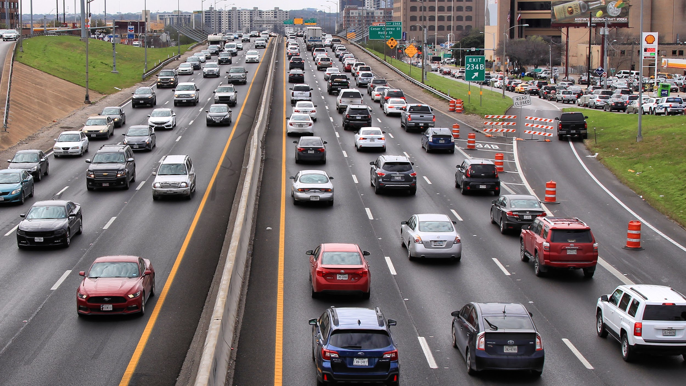
Fatal Traffic Accidents
Surviving Your Commute in Austin, Texas.
Michelle Parrish
General Assembly DSI Capstone

Slide 2

Problem Statement
Identify the predictors of vehicle crashes
In an accident, what are the predictors of a fatality?
Leading to Prevention
Avoid fatal conditions
Improve road structures
Take preventative measures
Approximately 3,500 people die in traffic related crashes each year on Texas roads.

Slide 3
What is being done to reduce fatal crashes?
VisionZero by 2025
No Texting While Driving Law
Rideshare

Slide 4
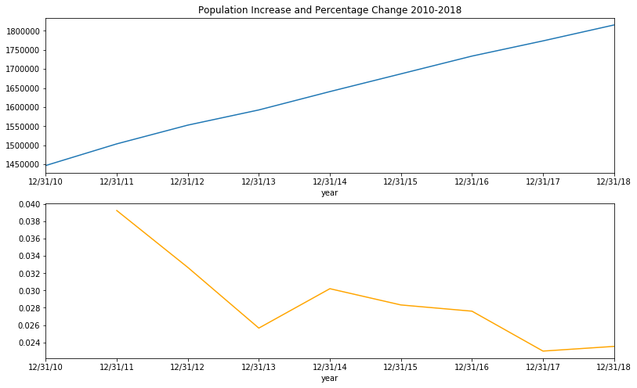
Austin Metro Area Population 2010 – 2018
And the Rate of Increase

Slide 5



Data
z

Slide 6
CRIS
Compiled by TX DOT from Officer Traffic Reports
CSV files can be requested from the CRIS administrators by year and location.
Data available for 2010-2018.
Using Python, the data was
Extracted from the Crash CSVs
Transformed and
Written to a PostgresSQL db

Slide 7
Exploratory Data Analysis
z
Data Imbalance
In statistical classification problems like this one, it is common to have an imbalance of data values. In the test dataset, there are 180 times more non - fatal than fatal accidents!
Feature Selection for Model
I chose to select data fields that are independent of crashes (ex. it is a Holiday). I want to create a predictor of crashes, not the root cause of a crash (ex. an animal in the road).

Slide 8
Features
Active School Zone | Holiday
City | Relation to an Intersection
County | Late Night 10pm-4am
Commuting Hours | Light Conditions
Crash Date | Construction Zone
Unique Identifier | Construction Worker Present
Speed Limit | Adjacent to Road
Crash Time | Roadway Type
Crash Date and Time | Railroad Crossing
Day of the Week | Rural Area
Weather Condition | Road Surface Condition
Weekend Day

Slide 9

Modeling
z

Slide 10
Logistic Regression
z
In a vehicle crash in Austin Metro Area, how likely are the chances of survival.
Using factors of crashes, predict whether the crash was fatal or not fatal. Fatal is the positive class in this model.
Reduce false negative results (Predicting non-fatal but was fatal)
Accuracy score is not the goal
 | Predicted Non-fatal | Predicted Fatal
Actual Non-Fatal | 51,852 | 20,435
Actual Fatal | 124 | 247

Slide 11

Results of Logistic Regression Model Features
Logistic Regression Model Coefficients
Code | Description | Value
wthr_cond_id_3 | SLEET/HAIL | 0.877016
wthr_cond_id_12 | CLOUDY | 0.886203
surf_cond_id_8 | OTHER | 0.955246
rpt_rdwy_sys_id_15 | COUNTY ROAD | 0.962821
rpt_rdwy_sys_id_8 | BUSINESS US | 1.021274
surf_cond_id_0 | UNKNOWN | 1.098617
rpt_rdwy_sys_id_6 | RANCH TO MARKET | 1.624524
surf_cond_id_10 | SAND, MUD, DIRT | 2.302769
wthr_cond_id_7 | SEVERE CROSSWINDS | 2.398391
Decrease Risk of Fatality
wthr_cond_id_4 | SNOW | -2.983766
wthr_cond_id_8 | OTHER | -2.892655
rpt_rdwy_sys_id_10 | BUSINESS FM | -2.884512
rpt_rdwy_sys_id_16 | PARK ROAD | -2.583594
surf_cond_id_5 | SLUSH | -1.659718
rpt_rdwy_sys_id_13 | ALTERNATE | -1.366951
road_part_adj_id_3 | ADJACENT ENTRANCE/ON RAMP | -1.298533
surf_cond_id_9 | SNOW | -1.093348
light_cond_id_6 | DARK, UNKNOWN LIGHTING | -1.057485

Slide 12
Results of Logistic Regression Model City
Logistic Regression Model Coefficients
Code | Description | Value
city_id_451 | WEST LAKE HILLS | -5.35489
city_id_1378 | SUNSET VALLEY | -5.10948
city_id_138 | ELGIN | -3.09526
city_id_1258 | ROLLINGWOOD | -2.39071
city_id_809 | GRANGER | -0.90166
city_id_577 | BRIARCLIFF | -0.85781
Increase Risk of Fatality
city_id_976 | LIBERTY HILL | 2.36455
city_id_1451 | WEIR | 2.109788
city_id_763 | FLORENCE | 2.046885
city_id_4836 | JARRELL | 1.913382
city_id_1088 | MUSTANG RIDGE | 1.747498
city_id_895 | JONESTOWN | 1.689415
city_id_421 | TAYLOR | 1.544575
city_id_8862 | VOLENTE VILLAGE | 1.530433
city_id_1811 | RURAL WILLIAMSON COUNTY | 1.483608
city_id_671 | CREEDMOOR | 1.152944
city_id_1792 | RURAL TRAVIS COUNTY | 0.987421

Slide 13
AdaBoost Random Forest
z
In a vehicle crash in Austin Metro Area, how likely are the chances of survival.
Using factors of crashes, predict whether the crash was fatal or not fatal. Fatal is the positive class in this model.
Reduce false negative results (Predicting non-fatal but was fatal)
Accuracy score is not the goal
 | Predicted Non-fatal | Predicted Fatal
Actual Non-Fatal | 52,010 | 20,277
Actual Fatal | 128 | 243

Slide 14
Results of AdaBoost Model Features 1
AdaBoost Feature Importances
Code | Description | Value
comut_hrs | M-F 5am-10am, 4pm-7pm | 0.02
day_of_week_2 | TUESDAY | 0.02
day_of_week_5 | FRIDAY | 0.02
holiday | FEDERAL HOLIDAY | 0.02
intrsct_relat_id_1.0 | INTERSECTION | 0.02
intrsct_relat_id_2.0 | INTERSECTION RELATED | 0.02
intrsct_relat_id_3.0 | DRIVEWAY ACCESS | 0.02
intrsct_relat_id_4.0 | NON INTERSECTION | 0.02
late_night | BETWEEN 10 PM - 4 AM | 0.02
light_cond_id_0 | UNKNOWN | 0.02
light_cond_id_1 | DAYLIGHT | 0.02
light_cond_id_4 | DARK, LIGHTED | 0.02
light_cond_id_5 | DUSK | 0.02
light_cond_id_6 | DARK, UNKNOWN LIGHTING | 0.02
road_constr_zone_fl | CONSRTUCTION ZONE | 0.02
road_part_adj_id_3 | ADJACENT ENTRANCE/ON RAMP | 0.02
road_part_adj_id_7 | OTHER | 0.02

Slide 15
Results of AdaBoost Model Features 2
AdaBoost Feature Importances
Code | Description | Value
rpt_rdwy_sys_id_11 | STATE LOOP | 0.02
rpt_rdwy_sys_id_12 | TOLL ROAD | 0.02
rpt_rdwy_sys_id_15 | COUNTY ROAD | 0.02
rpt_rdwy_sys_id_19 | LOCAL ROAD | 0.02
rpt_rdwy_sys_id_3 | STATE HIGHWAY | 0.02
rpt_rdwy_sys_id_4 | FARM TO MARKET | 0.02
rpt_rdwy_sys_id_5 | RANCH ROAD | 0.02
rpt_rdwy_sys_id_6 | RANCH TO MARKET | 0.02
rural_fl | RURAL | 0.02
surf_cond_id_10 | SAND, MUD, DIRT | 0.02
surf_cond_id_8 | OTHER | 0.02
weekend | SATURDAY OR SUNDAY | 0.02
wthr_cond_id_12 | CLOUDY | 0.02
wthr_cond_id_2 | RAIN | 0.02
wthr_cond_id_7 | SEVERE CROSSWINDS | 0.02
rpt_rdwy_sys_id_1 | INTERSTATE | 0.04
crash_speed_limit | SPEED LIMIT | 0.1

Slide 16
Modeling Results
z
City had a larger effect on fatal crashes than anticipated.
Severely windy days or sand/mud covering the roadway or increased Fatality.
Optimized for reducing False Negative (Type II) errors.
Speed Limits, Snow and Smaller Roads decreased Fatality.

Slide 17

Time Series Analysis
z

Slide 18
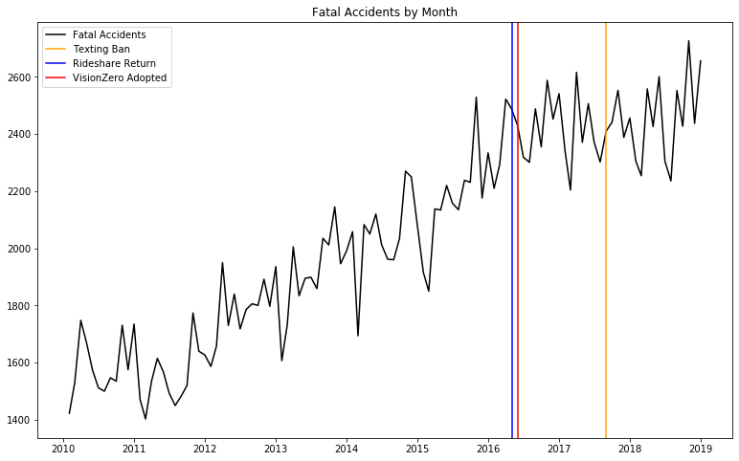
Timeseries Fatal Accidents by Month
Number of Fatalities
Year

Slide 19
Information architecture

Slide 20
Timeseries Trend and Seasonality by Month

Slide 21
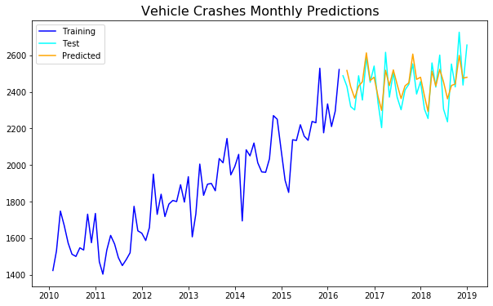
Timeseries Prediction Outcomes
Number of Fatalities
Year

Slide 22
Time Series Results
Predicted values followed the test set of data
A positive trend is present.
The trend may be slowing
Fatal accidents are seasonal, on a 4 month cycle.

Slide 23

Next Steps

Slide 24
What next?
z
Plot more events to Time Series from VisionZero to better visualize how the trend is changing
Incorporate 2019 data
More Feature Engineering to create better predictors
Map fatal accidents
Iterate AdaBoost output through better performing algorithms to improve Type II errors.
Create Commuter Survival Prediction Tool

Slide 25

Questions?

